Slide 2
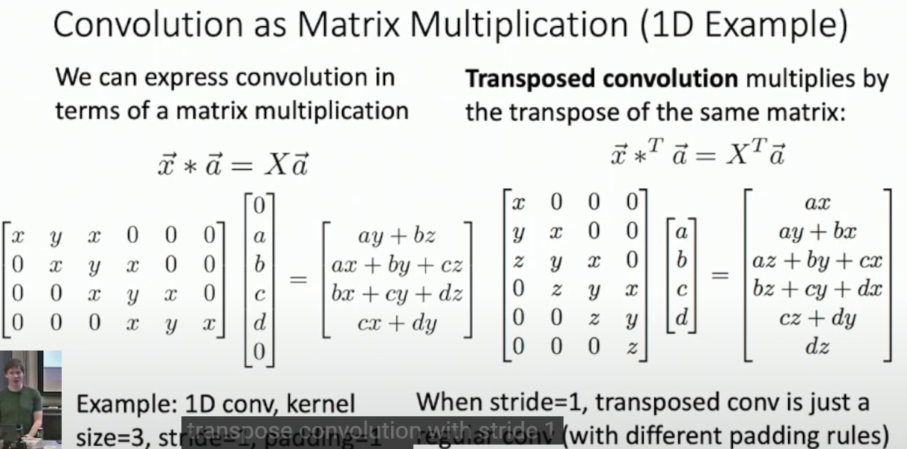
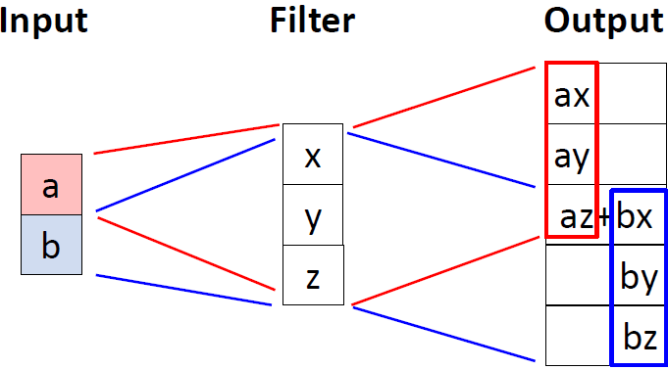
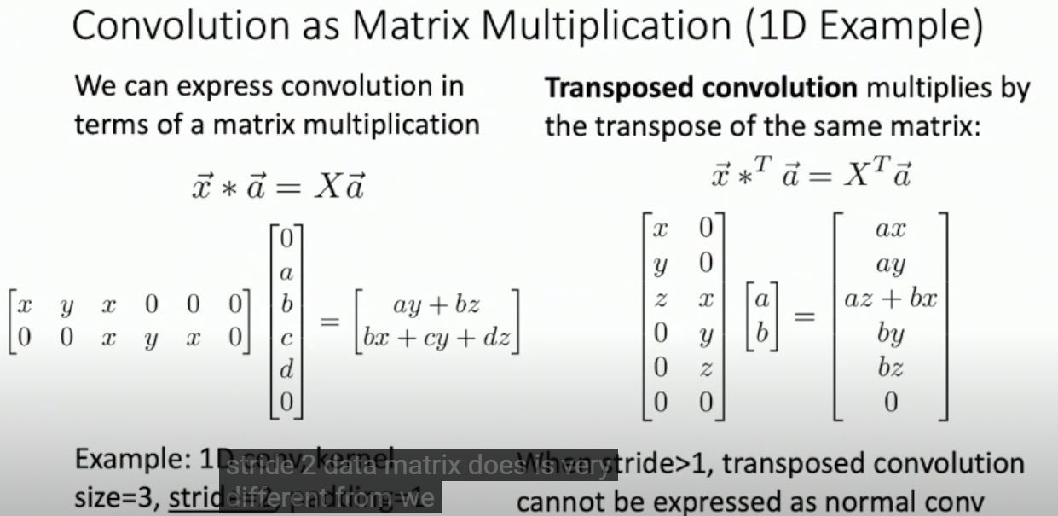

Slide 3
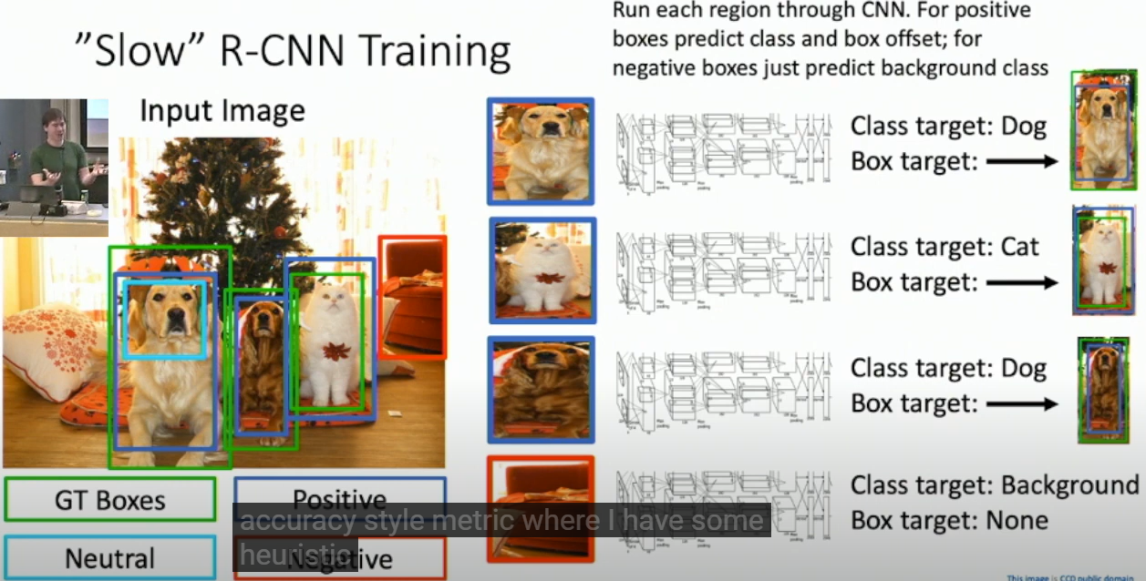
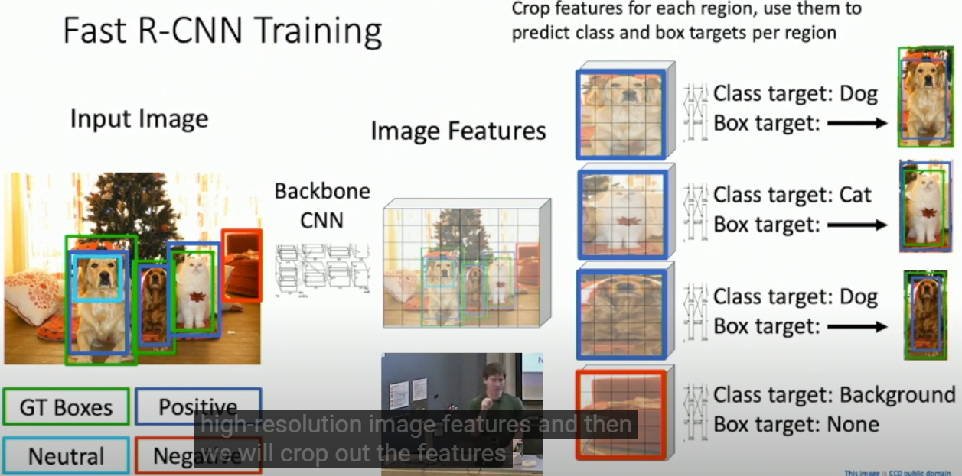

Slide 4
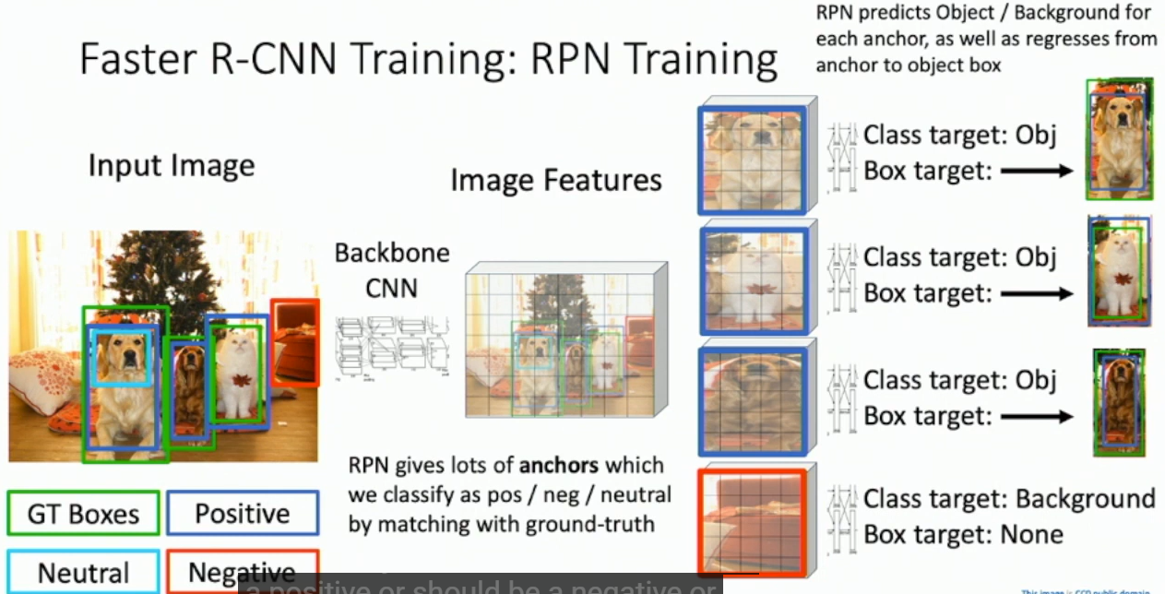
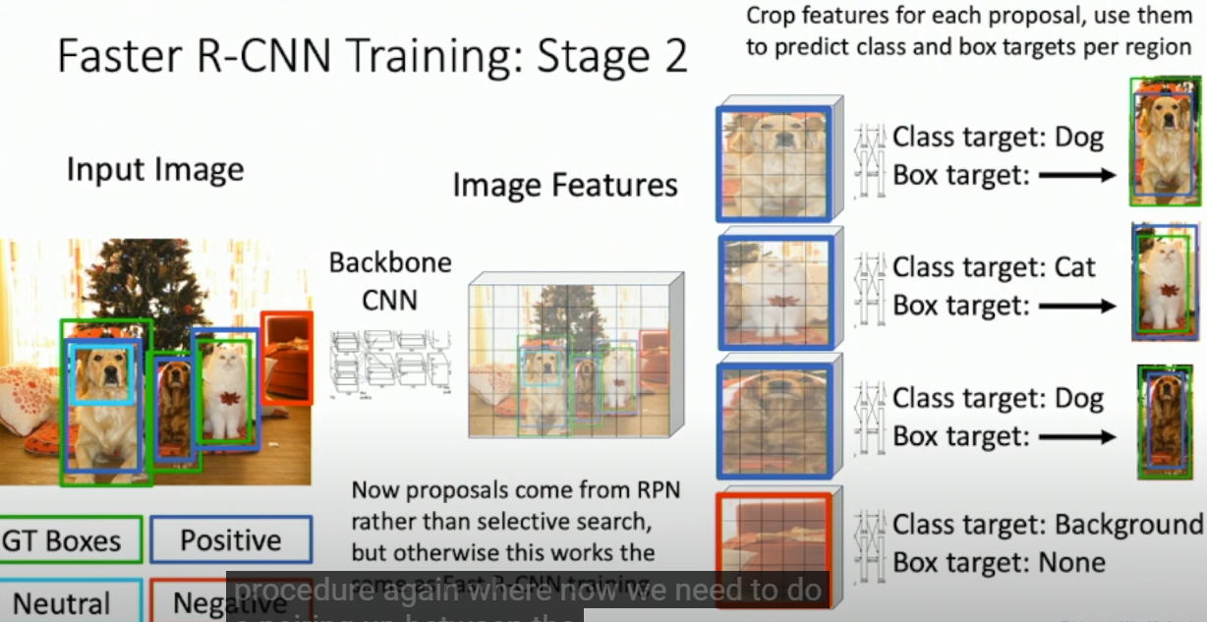

Slide 5
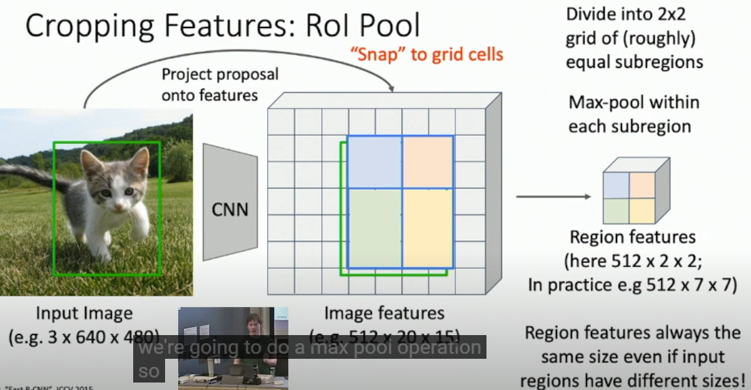
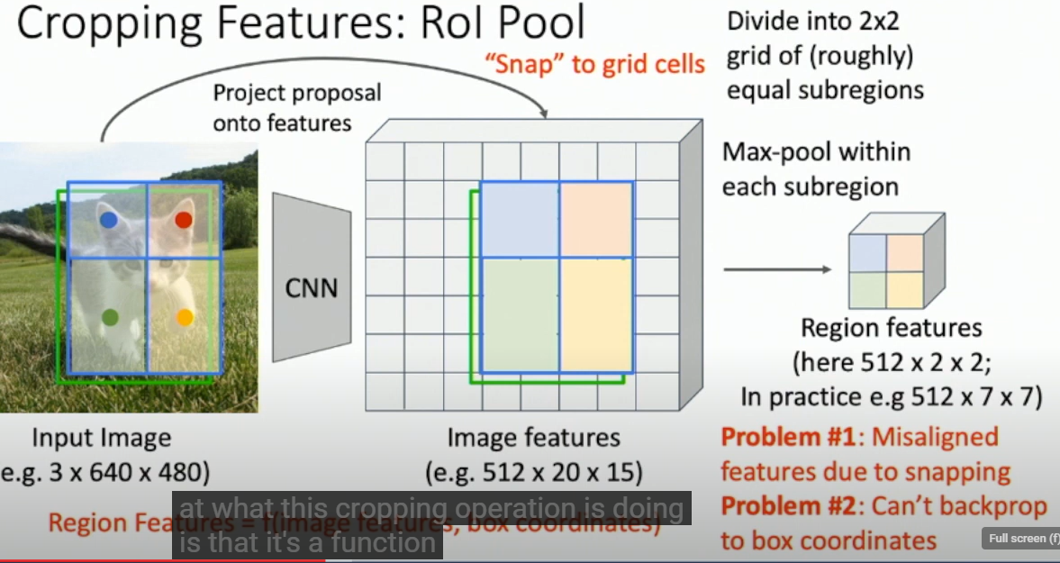
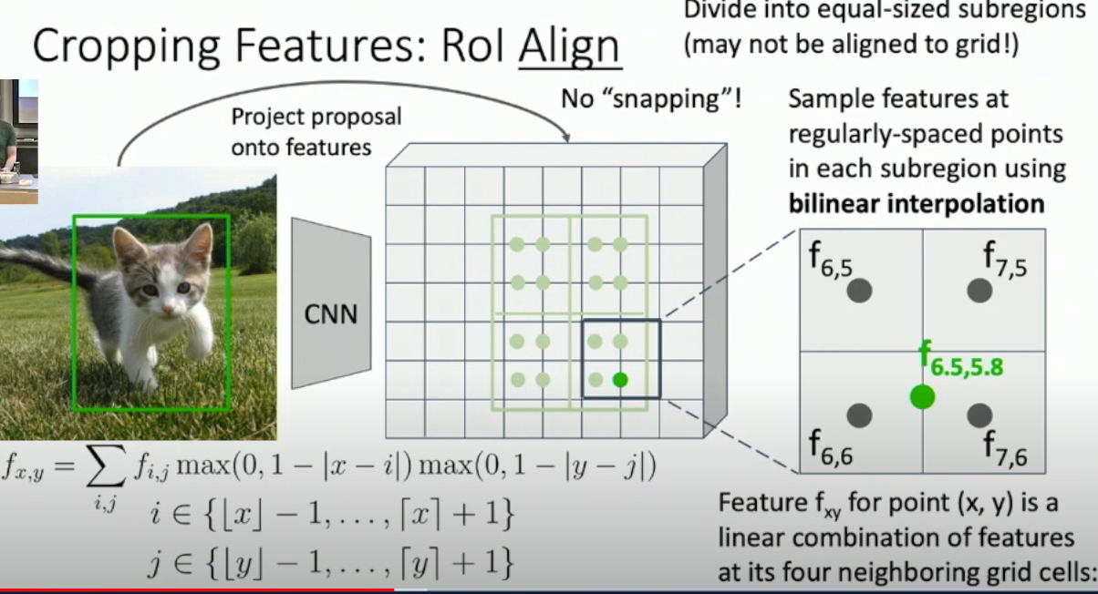
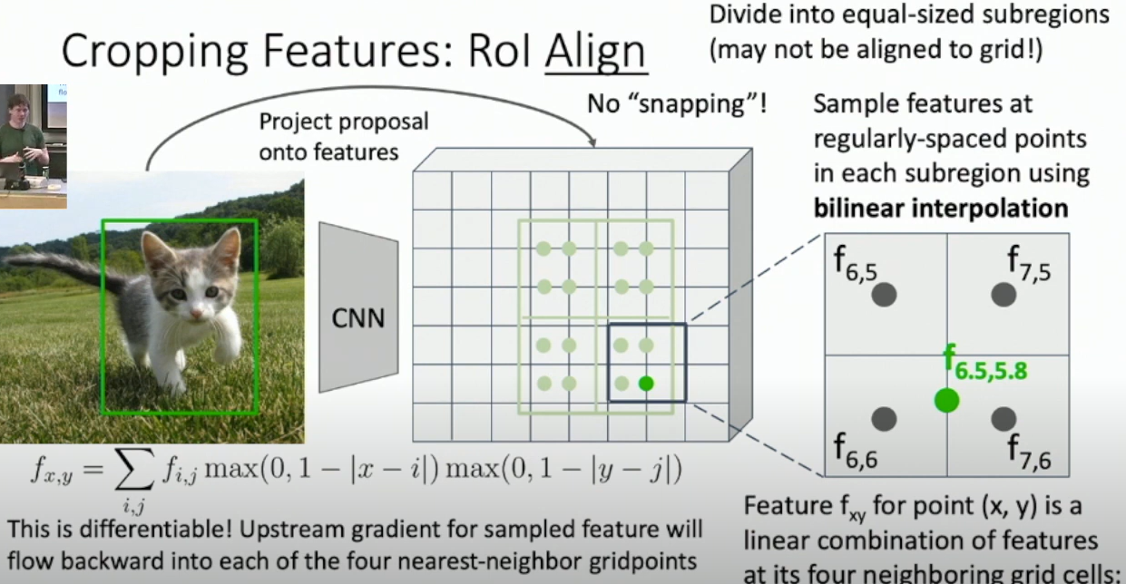
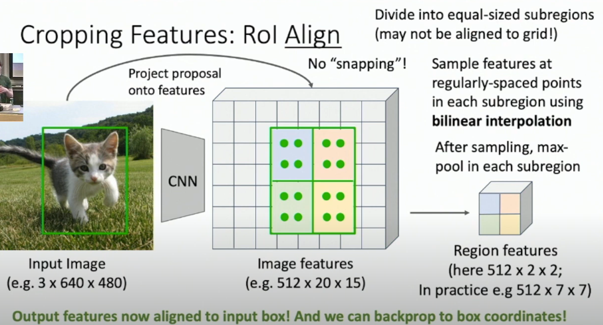
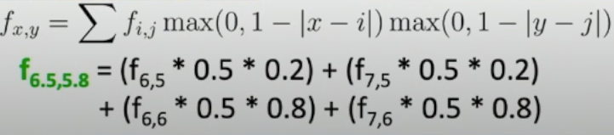

Slide 6
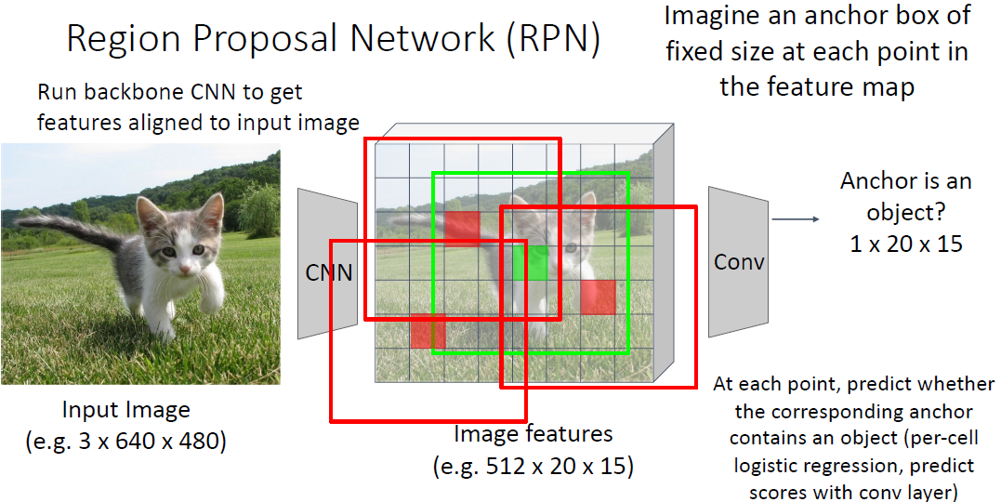
Region Proposal Network
Perform binary prediction for each anchor box
The red anchor boxes are predicted false (contains no object) and discarded; the green anchor box is predicted true (contains an object) and survives

Slide 7
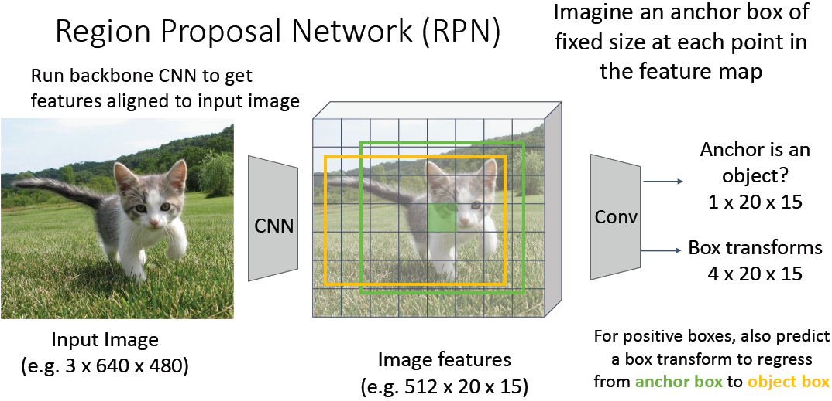
Region Proposal Network
Bbox regression: transform each positive anchor box (green), into a better-fitting (higher IoU with the Ground-Truth Bbox) object box (yellow)
Notes:
Bounding box regression: transform each region proposal with learnable parameters $(t_{x},t_{y},t_{h},t_{w})$ into a better bounding box

Slide 8
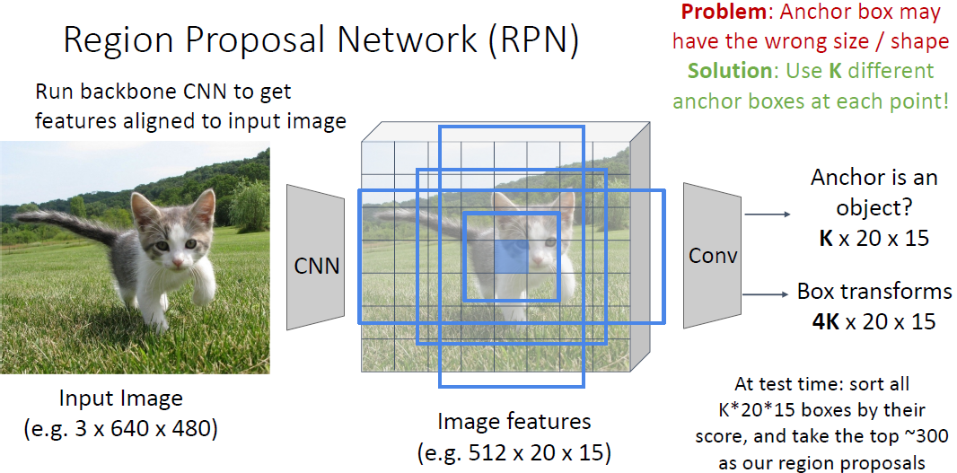
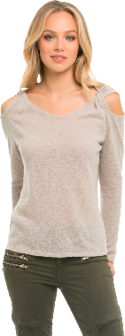
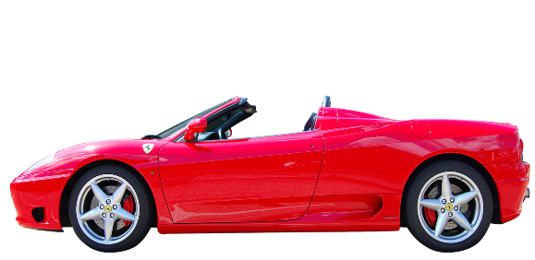
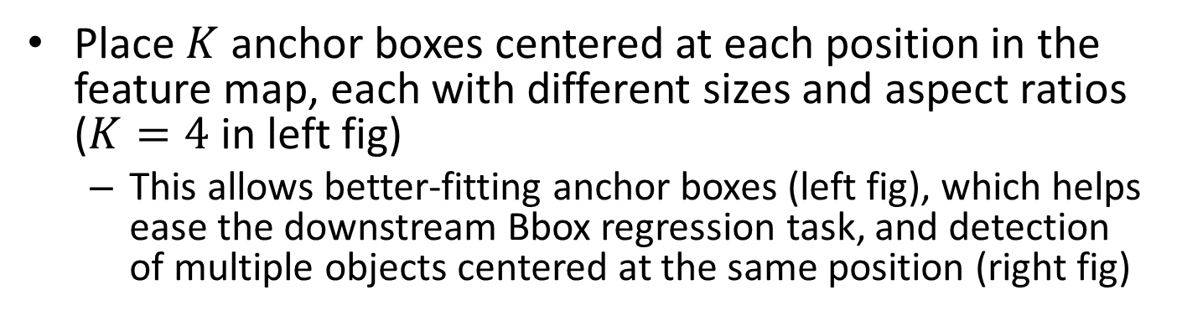
Region Proposal Network
Place $K$ anchor boxes centered at each position in the feature map, each with different sizes and aspect ratios ($K=4$ in left fig)
This allows better-fitting anchor boxes (left fig), which helps ease the downstream Bbox regression task, and detection of multiple objects centered at the same position (right fig)

Slide 9
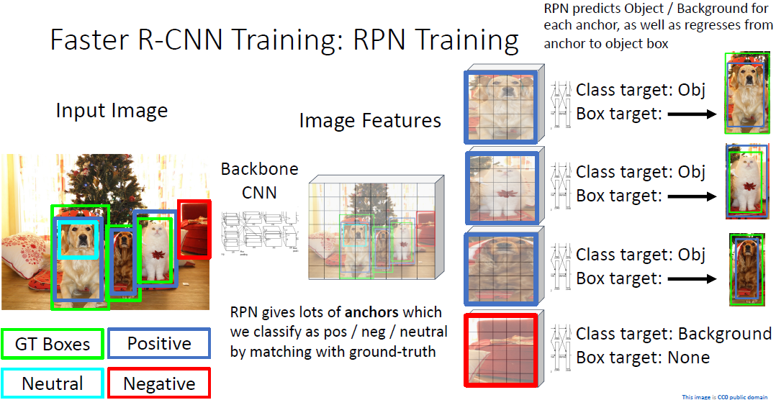
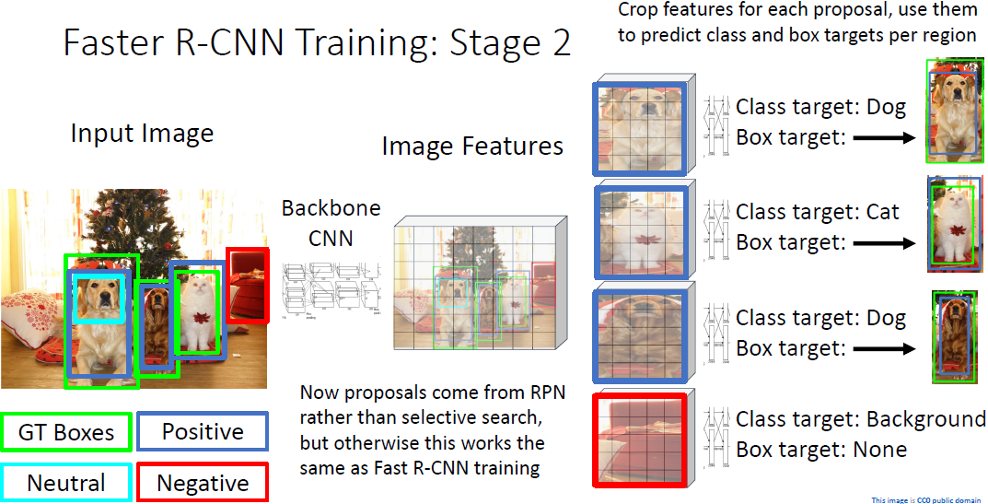

Slide 10
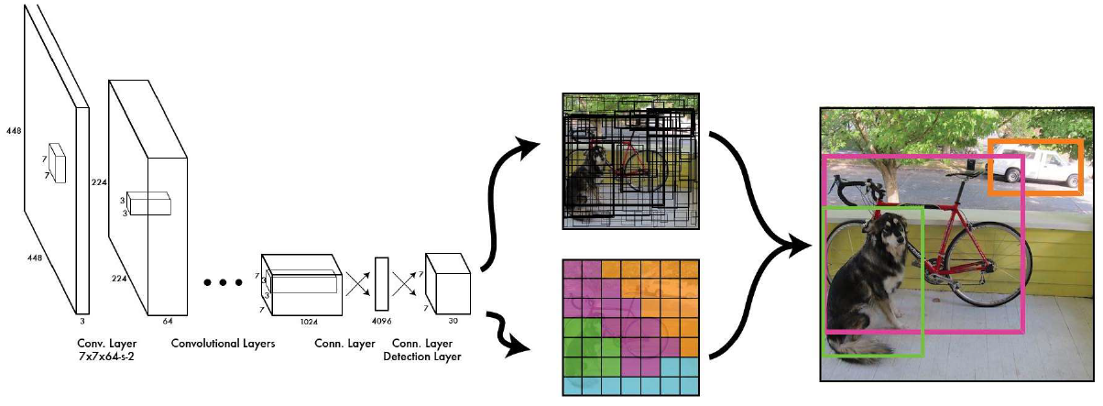

Slide 11
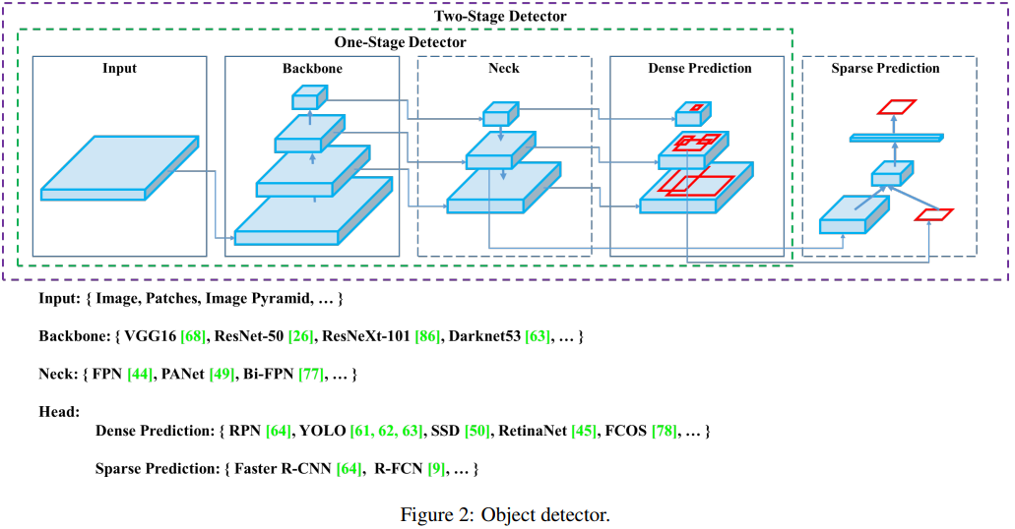
YOLO Architecture

Slide 12
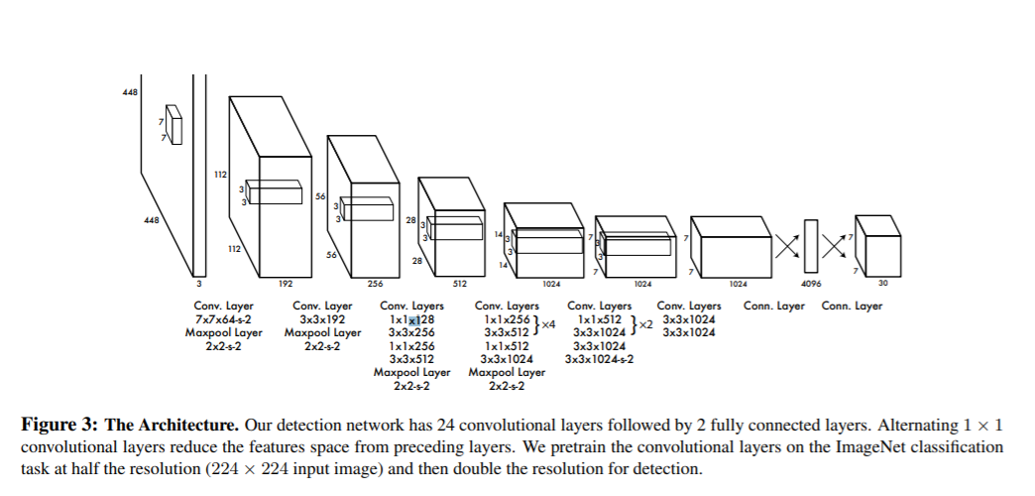
YOLOv1
YOLO consists of 24 CONV layers followed by two FC layers.
It takes an input image of dimension 224x224 and resizes it to 448x448. The output is a 7x7x30 tensor containing predictions which the model makes on the input image
Much faster than two-stage algorithms, e. g., RCNN, Fast RCNN, masks RCNN.
https://papers.readthedocs.io/en/latest/imagedetection/yolo/
Notes:
This means that prediction in the entire frame is made in a single forward pass, to predict various class probabilities and bounding boxes simultaneously.

Slide 13
USENIX Security '21 - SLAP: Improving Physical Adversarial Examples with Short-Lived Adversarial
https://www.youtube.com/watch?v=o4LrVm5LP2E

Slide 14
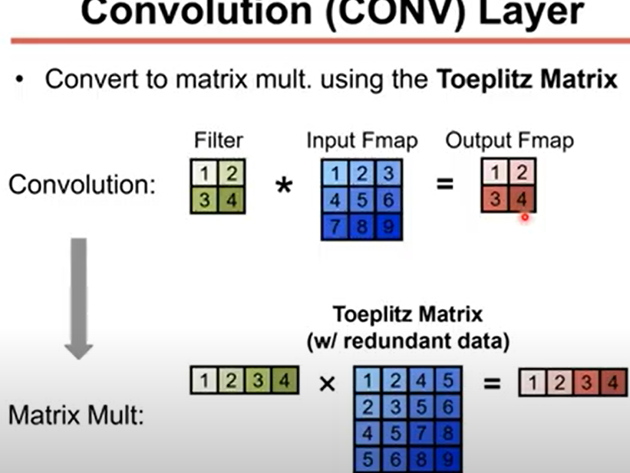
Toeplitz Matrix

